Slide 1



Slide 2

The Road Not TAKEN
By ;- Robert Frost

Slide 3
Introduction
In the poem – ‘The Road Not Taken’, the road symbolizes our life. The poet says that the path that we don’t choose in our life is the road not taken. He describes his feelings about that choice that he had left in the past. The path which we have chosen, decides our future, our destination. The important message that the poet wants to give is that the choice that we make has an impact on our future and if we make a wrong choice, we regret it but cannot go back on it. So, we must be wise while making choices.

Slide 4
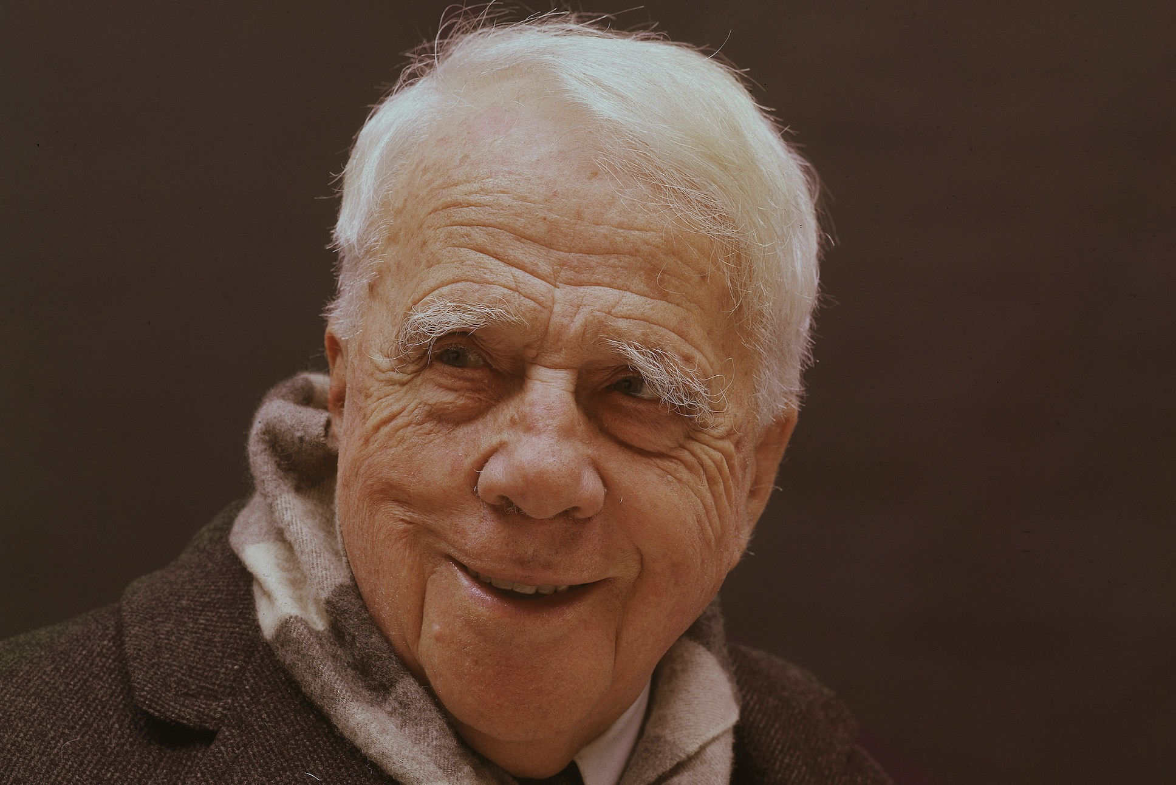
About the Author
Robert Lee Frost (March 26, 1874 – January 29, 1963) was an American poet. His work was initially published in England before it was published in the United States. Known for his realistic depictions of rural life and his command of American colloquial speech,
Frost frequently wrote about settings from rural life in New England in the early 20th century, using them to examine complex social and philosophical themes.

Slide 5
TABLE OF CONTENTS
01
02
03
04
Explanation
Poetic Devices
Difficult Words
Questions

Slide 6
Two roads diverged in a yellow wood, And sorry I could not travel both And be one traveler, long I stood And looked down one as far as I could To where it bent in the undergrowth;

Slide 7
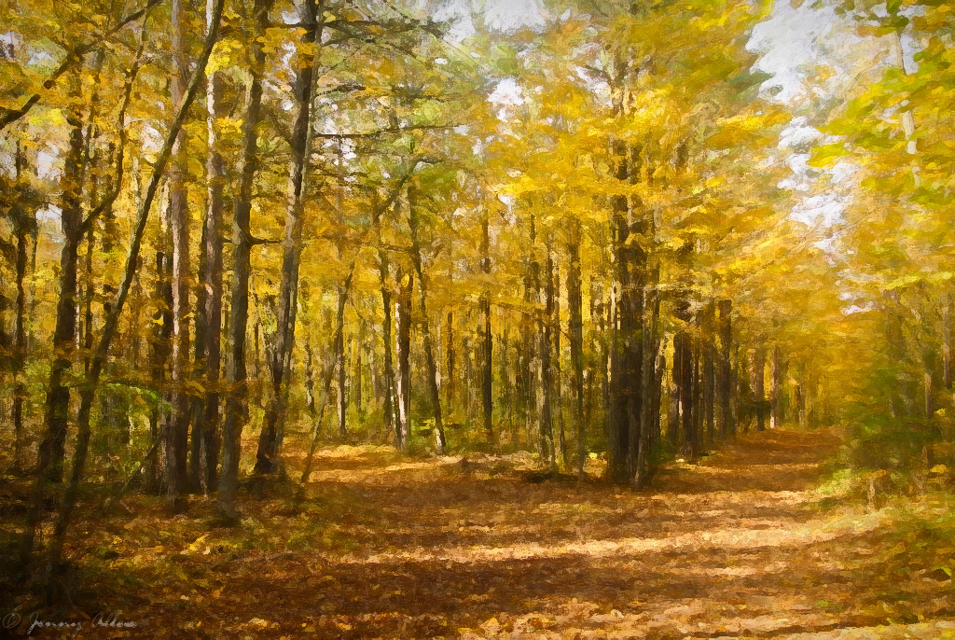
This stanza presents the main situation the poet’s faces. The context is of “a yellow wood” where the poet feels sorry that there are two roads and he has a choice to travel on one of them. The reason is he is a single person and not a double.
Therefore, he needs to travel only once after looking at one of them that it is less traveled and that it shows undergrowth which means very few people have traveled through it. The stanza contributes to the main idea of choice in one’s life by presenting two roads, their contexts, and situations.

Slide 8
Poetic Devices:
Anaphora
Symbolism
Repetition of 'And' at the beginning of lines 2, 3, and 4.
The road is a representation for the journey or the life choice that the poet makes.

Slide 9
Poetic Devices:
Enjambment
Metaphor
Lines 3, 4, and 5 have a continuous flow with any punctuation mark.
The word undergrowth stands for the future into which the poet cannot see.
The road is a metaphor for the choices we make in life.

Slide 10
Difficult Words:
Diverged
Undergrowth
separated and took a different direction
dense growth of plants and bushes means the forest
Yellow Wood
a forest with decomposing leaves

Slide 11
Then took the other, as just as fair, And having perhaps the better claim, Because it was grassy and wanted wear; Though as for that the passing there Had worn them really about the same,

Slide 12
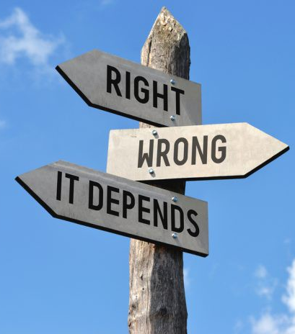
The poet choose the road which was grassy and unused which symbolized a decision which isn't made as often as the other, 'perhaps having a better claim' as both the decisions had the same chances of having good results or maybe this one had better the poet choose it with the assumption that it hadn't been used as he went on his journey though he realized that both the paths had been used just as often but the one he took was just uncommon.

Slide 13
Poetic Devices:
Simile
Alliteration
Both the roads have been compared to each other using the words 'as just as fair'
Repetition of 'd' sound in 'then' and 'the’.
Repetition of 'w' sound in 'wanted' and 'wear'.

Slide 14
Poetic Devices:
Imagery
Personification
The poet gives us a visual description of the two roads. He says that one was grassy as there were hardly any travelers walking down that road.
The road here is personified as wanting humans to travel down its path.

Slide 15
Difficult Words:
Better Claim
Preferable
OR
Better Choice
Wanted Wear
the road had been worn badly

Slide 16
And both that morning equally lay In leaves no step had trodden black. Oh, I kept the first for another day! Yet knowing how way leads on to way, I doubted if I should ever come back.

Slide 17
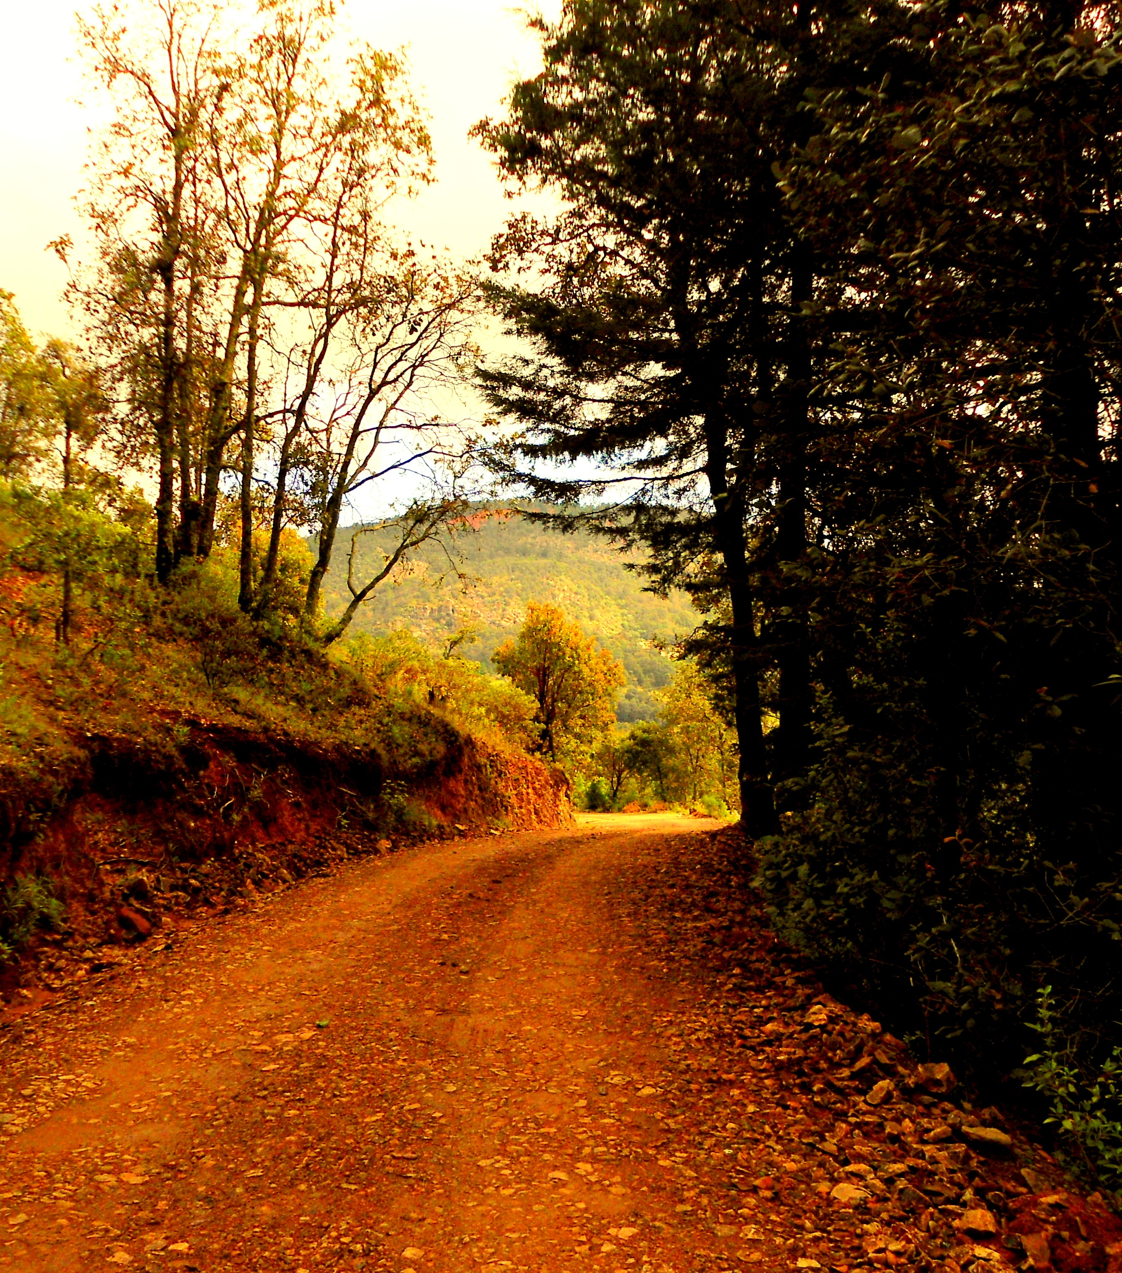
Reinforcing this statement, the speaker recalls that both roads were covered in leaves, which had not yet been turned black by foot traffic. The speaker exclaims that he or she is in fact just saving the first road, and will travel it at a later date, but then immediately contradicts him or herself with the acknowledgement that, in life, one road tends to lead onward to another, so it's therefore unlikely that he or she will ever actually get a chance to return to that first road.

Slide 18
Poetic Devices:
Repetition
Alliteration
Repetition of 'f' sound in 'first' and 'for'.
The word 'way' has been repeated twice.

Slide 19
Poetic Devices:
Enjambment
Imagery
The poet gives a beautiful description of both the roads that morning. He says that they lay equal with none of the leaves turned black by the footsteps of a passerby.
Line 1 continues into line 2 without any punctuation.

Slide 20
Difficult Words
Equally Lay
lying in the same manner
Trodden
walk in a specified way.

Slide 21
I shall be telling this with a sigh
Somewhere ages and ages hence;
Two roads diverged in a wood, and I-
I took the one less travelled by,
And that has made all the difference.

Slide 22

The poet says that someday he'll tell his story and the decisions he made one day to other. With a sigh of relief of making the right decision or disappointment of never picking the first road , he'll tell how he had to choose between two paths and how he'd choose the one which was less travelled. The changes it'd bring in his journey, how a single decision can make an impact on his life.

Slide 23
Poetic Devices:
Repetition
Enjambment
The word 'ages' has been repeated twice in the second line.
The line 'Two roads diverged in' has been repeated here again.
Line 1 continues into line 2 without any punctuation.

Slide 24
02
Questions
Lets see if you remember what we told you all

Slide 25
Where does the traveller find himself?What problem does he face?

Slide 26
The traveller finds himself at a point where two roads diverge. His problem is to decide on which road he should walk
ANSWER

Slide 27
What does ‘yellow wood' mean?

Slide 28
Any of a number of trees which have yellowish timber or yield a yellow dye.
ANSWER

Slide 29
Which road did the poet choose and why?

Slide 30
The poet took the second path which was grassy and inviting as it was less travelled on and looked like it wanted to be used
ANSWER

Slide 31
What had the poet discovered after he started travelling on the path?

Slide 32
The poet discovered that the road was alike to the first one, both being fair and had been used almost as often as the other.
ANSWER

Slide 33
What will the poet be telling to others?

Slide 34
The poet one day in the future will tell people the decision he had made of choosing the less used path and what differences that had made in his life.
ANSWER

Slide 35
What is the theme of the stanza?

Slide 36
The theme of the stanza is reflective and tells that sometimes we have to make decisions which can't be undone.
ANSWER

Slide 37
Thank You
By:-
Suprito Ghosh | Suchismita
| Kansihka Kantura |

